Slide 1
CS3391 Object Oriented Programming
Dr.D.Sivaganesan, Professor,
PSGiTech / CSE

Slide 2
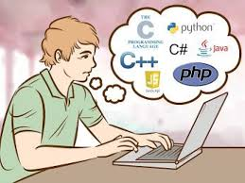
Programming Language
A programming language is a type of written language that tells computers what to do in order to work.
Programming languages are used to make all the computer programs and computer software.
A programming language is like a set of instructions that the computer follows to do something.

Slide 3
Developments in Software Technology
Developments in software technology continue to be dynamic.
New tools and techniques are announced in quick succession.
This has forced the software engineers and industry to continuously look for new approaches to software design and development

Slide 4
Developments in Software Technology
ADD,SUB,MUL,DIV .
Ex: Z80,8085MP,8086 MP.
English Words and Symbols +,*,-,/ ..
EX: Basic,Cobol,C
English Words and Symbols +,*,-,/ ..
EX: C++,Java,Small Talk..

Slide 5
Procedure Oriented Programming(POP)
Program is divided into small parts called functions

Slide 6
Procedure Oriented Programming(POP)

Slide 7
Object-Oriented Programming(OOP)
Program is divided into parts called objects.

Slide 8
Definition - OOP
Object-Oriented Programming (OOP) is a programming language model organized around objects rather than actions and data.
An object-oriented program can be characterized as data controlling access to code.

Slide 9
POP vs OOP
Procedure-Oriented Programming (POP) | Object-Oriented Programming(OOP)
In POP, program is divided into small parts called functions | In OOP, program is divided into parts called objects.
In POP,Importance is not given to data but tofunctions as well as sequence of actions to be done. | In OOP, Importance is given to the data rather than procedures or functions because it works as a real world.
POP follows Top Down approach. | OOP follows Bottom Up approach.
POP does not have any access specifier. | OOP has access specifiers named Public, Private, Protected, etc.
In POP, Data can move freely from function to function in the system. | In OOP, objects can move and communicate with each other through member functions.
To add new data and function in POP is not so easy. | OOP provides an easy way to add new data and function.
In POP, Most function uses Global data for sharing that can be accessed freely from function to function in the system. | In OOP, data can not move easily from function to function,it can be kept public or private so we can control the access of data.
POP does not have any proper way for hiding data so it is less secure. | OOP provides Data Hiding so provides more security.
In POP, Overloading is not possible. | In OOP, overloading is possible in the form of Function Overloading and Operator Overloading.
Example of POP are : C, VB, FORTRAN, Pascal. | Example of OOP are : C++, JAVA, VB.NET, C#.NET.

Slide 10
Basic Concepts of OOP
Object
Class
Data Abstraction
Data Encapsulation
Inheritance
Polymorphism
Object Communications

Slide 11
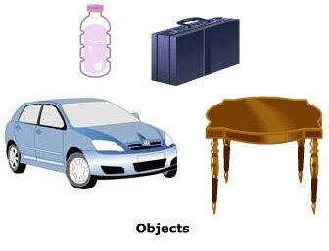
Object
Object means a real word entity such as Car, table etc.
Any entity that has state and behavior is known as an object.
An object has three characteristics:
state: represents data (value)
behavior: represents the behavior (functionality)
Unique Identity

Slide 12
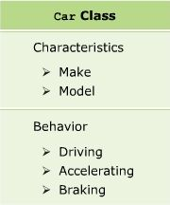
Class
Collection of objects is called class. It is a logical entity
A class can also be defined as a blueprint from which you can create an individual object.
A class consists of Data members and methods with access modifiers

Slide 13
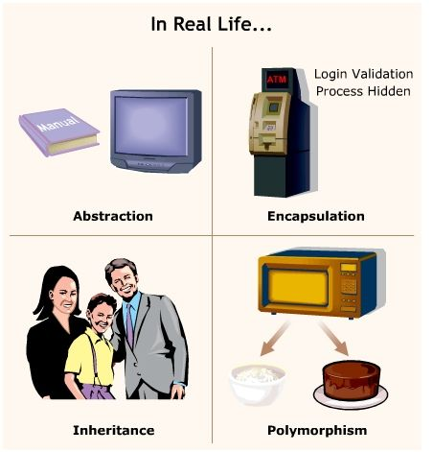
Data Abstraction
Abstraction refers to the act of representing essential features without including the background details or explanations.
Abstraction is the feature of extracting only the required information from objects.

Slide 14

Data Encapsulation
The wrapping up of data and functions into a single unit is known as encapsulation.
Data Hiding – Security

Slide 15
Inheritance
Inheritance can be defined as the procedure or mechanism of acquiring all the properties and behavior of one class to another,
Acquiring the properties and behavior of child class from the parent class.
When one object acquires all the properties and behaviors of another object, known as inheritance.
Reusability

Slide 16
Polymorphism
Polymorphism is derived from two Greek words, namely poly and morphos
Poly means many and morphos means forms.
Polymorphism means existing in multiple forms. Polymorphism is the ability to take more than one form.
When one task is performed by different ways i.e. known as polymorphism

Slide 17

Object Communication
Objects communicate with one another by sending and receiving information to each other on demand

Slide 18
Thank you

